Slide 1
Galaxy Ind. PMO
Project Management

Slide 2
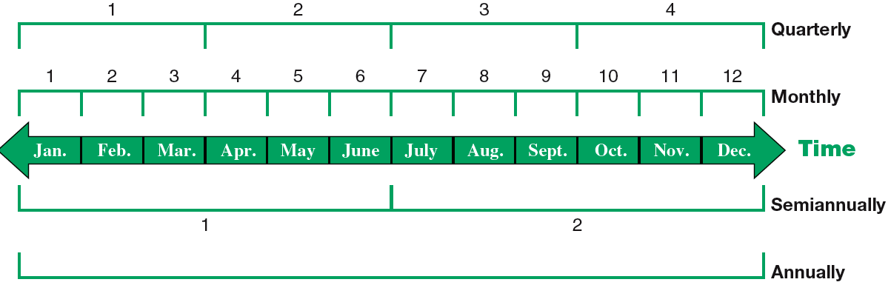
The Accounting Period
Exhibit 3.1
Access the text alternative for slide images.
Learning Objective C1: Explain the importance of periodic reporting and the role of accrual accounting.
Notes:
To provide timely information, accounting systems prepare reports at regular intervals. The time period assumption presumes that an organization’s activities can be divided into specific time periods such as a month, a three-month quarter, a six-month interval, or a year. Most organizations use a year as their primary accounting period. Many organizations also prepare interim financial statements covering one, three, or six months of activity. Reports covering a one-year period are known as annual financial statements.
An organization can use a fiscal year which consists of any 12 consecutive months, or 52 weeks. A natural business year end is when sales for a company are at their lowest level for the year.

Slide 3
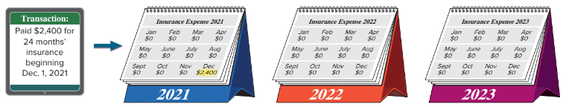
Accrual Basis versus Cash Basis Accrual Basis Example 2
Exhibit 3.3
On December 1, 2021, Galaxy paid $2,400 cash for a 24 month business insurance policy.
Using the cash basis, the entire $2,400 would be recognized as insurance expense in 2021. No insurance expense from this policy would be recognized for the 2022 or 2023 periods covered by the policy.
Access the text alternative for slide images.
Learning Objective C1: Explain the importance of periodic reporting and the role of accrual accounting.
Notes:
In our first transaction, on December 1, 2021, FastForward paid $2,400 cash for a 24 month business insurance policy.
On the cash basis, the entire $2,400 would be recognized as an expense in 2021 even though the policy provides protection for 2021, 2022, and part of 2023.

Slide 4
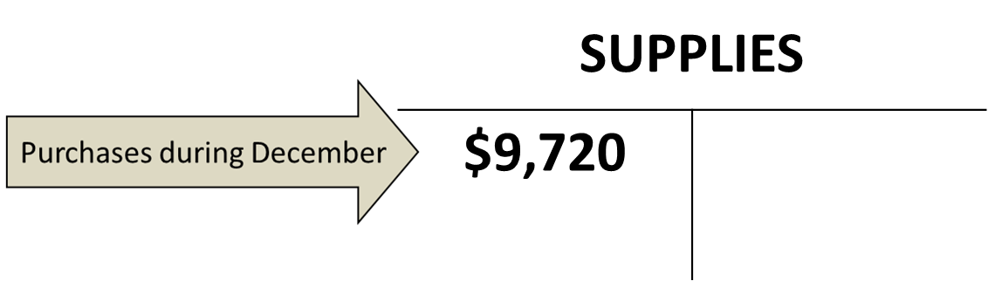
Adjusting for Supplies Steps 1 and 2
Step 1: Galaxy purchased $9,720 of supplies in December. Some of these supplies were used during December.
Step 2: A physical count performed on 12/31 shows that unused supplies equal $8,670.
SUPPLIES
$9,720
Learning Objective P1: Prepare adjusting entries for deferral of expenses.
Notes:
FastForward purchased $9,720 of supplies in December. Some of these were used during December.
Step 1: Current balance equals $9,720.
Step 2: A physical count performed on 12/31 shows that unused supplies equal $8,670.

Slide 5
Adjusting for Depreciation – Step 1
Galaxy purchased equipment on Dec. 1 for $26,000.
It has an estimated useful life of five years.
The equipment is expected to be worth about $8,000 at the end of five years.
They purchased the equipment on Dec. 1 but it is now Dec. 31.
Because Galaxy expects the equipment to be worth $8,000
when the five years are over, only $18,000 of the cost will be
spread over the next 5 years (60 months).
Learning Objective P1: Prepare adjusting entries for deferral of expenses.
Notes:
Let’s look at a depreciation adjustment for FastForward. The company purchased equipment on Dec. 1 for $26,000. It has an estimated useful life of 5 years or 60 months. The equipment is expected to be worth about $8,000 at the end of five years. They purchased the equipment on Dec. 1 but it is now Dec. 31. We will depreciate the net cost of $18,000 over its useful life of 5 years (60 months). Let’s see how this is done.
Step 1 is the purchase of equipment for $26,000. The equipment’s cost must be depreciated.

Slide 6
Straight-Line Depreciation
Step 1: Galaxy purchased equipment on December 1 for $26,000.
Calculate Net Cost (amount to depreciate).
Learning Objective P1: Prepare adjusting entries for deferral of expenses.
Notes:
Straight-line depreciation is calculated as shown on this slide. To calculate the net cost of the equipment over its useful life, we start with the $26,000 purchase price and subtract the salvage value of $8,000. This leaves a net cost of $18,000 and this is what we will depreciate.

Slide 7
Adjusting for Unearned Revenues Steps 1 and 2
Step 1: PMO’s client paid a 60-day fee in advance covering the period from 12/27 – 2/24 and recorded:
Dec. 26 Cash 3,000
Unearned Consulting Revenue 3,000
Received advance payment for services
Step 2: PMO earns payment as time passes. At 12/31, 5 days’ service is earned, 5/60 × $3,000 = $250.
Step 3: Adjusting entry reduces liability, Unearned Consulting Revenue, by $250 for 5 days’ of revenue. Consulting Revenue of $250 is earned.
Learning Objective P2: Prepare adjusting entries for deferral of revenues.
Notes:
FastForward’s client paid a 60-day fee in advance covering the period from 12/27 – 2/24 and recorded a debit to cash and a credit to unearned consulting revenue, a liability account.
Step 1: Current balance equals $3,000.
Step 2: FastForward earns payment as time passes. At 12/31, 5 days’ service is earned or 5/60 × $3,000 = $250.
Step 3: Adjusting entry reduces liability, Unearned Consulting Revenue, by $250 or 5 days’ worth of revenue. Also, Consulting Revenue of $250 is earned.

Slide 8
Adjusting for Accrued Salaries – Financial Statements
(Balance Sheet)
(Income Statement)
SALARIES PAYABLE
SALARIES EXPENSE
 | $210 12/31 adj.
 | $210 12/31 Bal.
12/12 12/26 12/31 adj. | $700 700 210
12/31 Bal. | $1,610
The Balance Sheet will show $210 of Salaries Payable owed.
The Income Statement will show $1,610 total Salaries Expense.
Learning Objective P3: Prepare adjusting entries for accrued expenses.
Notes:
During the month of December, salaries of $700 each were paid on 12/12 and 12/26, for a total of $1,400. After the adjustment, the Salaries Payable account will show the correct balance of $210 of salaries owed on the Balance sheet and the Salaries Expense account will report the correct amount of salaries expense on the Income Statement.

Slide 9
Future Cash Payment of Accrued Expenses
Accrued expenses at the end of one period result in a cash payment in a future period.
On 12/31, PMO recorded accrued salaries of $210.
On 1/9 of the next year, the following entry will reduce the accrued liability, salaries payable, and record the expense for 7 days of work in January.
Jan. 9 Salaries Payable (3 × $70) 210
Salaries Expense (7 × $70) 490
Cash 700
To record earned revenue received in advance
Learning Objective P3: Prepare adjusting entries for accrued expenses.
Notes:
FastForward recorded accrued salaries of $210. On January 9, the first payday of the next period, the following entry settles the accrued liability (salaries payable) and records salaries expense for seven days of work in January.
The $210 debit reflects the payment of the liability for the three days’ salary accrued on December 31. The $490 debit records the salary for January’s first seven working days (including the New Year’s Day holiday) as an expense of the new accounting period. The $700 credit records the total amount of cash paid to the employee.

Slide 10
Adjusting for Accrued Services Revenue Steps 1, 2, and 3
Step 1: On 12/12, PMO’s customer agreed to pay $2,700 on 1/10 of the next year for future services over the next 30 days.
Step 2: On 12/31, 20 days worth of services have been provided and earned which totals $1,800 ($2,700 × 20/30 days).
Step 3: Adjusting entry increases an asset, Accounts Receivable, and increases the Consulting Revenue account for $1,800 with the following journal entry:
Dec. 31 Accounts Receivable 1,800
Consulting Revenue 1,800
To record 20 days' accrued revenue.
Learning Objective P4: Prepare adjusting entries for accrued revenues.
Notes:
Step 1: On 12/12, FastForward’s customer agreed to pay $2,700 on 1/10 of the next year for future services over the next 30 days.
Step 2: On 12/31, 20 days worth of services have been provided and earned which totals $1,800 ($2,700 × 20/30 days).
Step 3: Adjusting entry increases an asset, Accounts Receivable, and increases the Consulting Revenue account for $1,800.

Slide 11
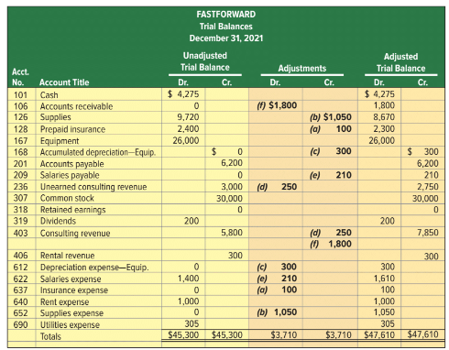
Adjusted Trial Balance
Exhibit 3.13
Learning Objective P5: Prepare financial statements from an adjusted trial balance.
Notes:
An Unadjusted Trial Balance is a list of accounts and balances prepared before adjustments are recorded. An Adjusted Trial Balance is a list of accounts and balances prepared after adjusting entries have been recorded and posted to the ledger. Here we show both the unadjusted and the adjusted trial balances for FastForward at December 31, 2021. The order of accounts in the trial balance is usually set up to match the order in the chart of accounts. Several new accounts arise from the adjusting entries.
Each adjustment (see middle columns) is identified by a letter in parentheses that links it to an adjusting entry explained earlier. Each amount in the Adjusted Trial Balance columns is computed by taking that account’s amount from the Unadjusted Trial Balance columns and adding or subtracting any adjustment(s).
Next, we will look at how to prepare financial statements from the adjusted trial balance.

Slide 12
Develop Risk Plan
Identify Risk
Analyze Risk
Document Risk
Making our information security policy effective requires a few key elements. It should be enforceable and practical, cover security from all angles across the organization, as well as focus of the business goals of the company. “Previous studies have revealed that employees’ information security awareness plays a vital role in mitigating the risk associated with their behavior in organizations” (Abawajy, 2014).

Slide 13
Oversight Controls
Oversight controls will be handled by the same company we outsourced for methodology and program management. They will assure the PMO project will be delivered according to an appropriate method using industry best practices. If the project is taking a turn towards a new scope in a reckless manner or scope creep, oversight will step in and correct the problem.

Slide 14
